Slide 1






Our Team
(Group leader)Tamiya Zulfiqar :34042
Hafsa Usman :33032
Kinza Anwar :22028
Sana Aslam : 32654
Dayem Mujahid: 35214
Leena Sohaib : 33436

Slide 2

Emergency Alert Button for Women's Safety
Empowering women with a quick, discreet, and reliable way to alert family or authorities during emergencies.

Slide 3
The Critical Need for Immediate Assistance
Women's safety is a paramount concern, especially in situations involving harassment, stalking, or sudden threats. Victims often struggle to seek help due to fear or limited access to communication tools.
Discreet Help
Time-Sensitive Situations
Ease of Access
Current methods often require visible phone use, which can escalate danger in critical moments.
Every second counts when facing a threat; delays in communication can have severe consequences.
Panic can make unlocking a phone or navigating apps difficult under pressure, hindering quick alerts.

Slide 4




Introducing the Portable Emergency Alert Button
Our solution is a portable emergency alert button designed for rapid response in dangerous situations, ensuring speed, simplicity, and safety.
Instant Alerts
Real-Time GPS
Sends SMS or app notifications to pre-registered emergency contacts.
Shares live location for precise tracking and quicker response.
Audible & Visual Cues
Fast Communication
Activates a buzzer or flash to draw immediate public attention.
Enables alerts without unlocking phones or opening apps.

Slide 5
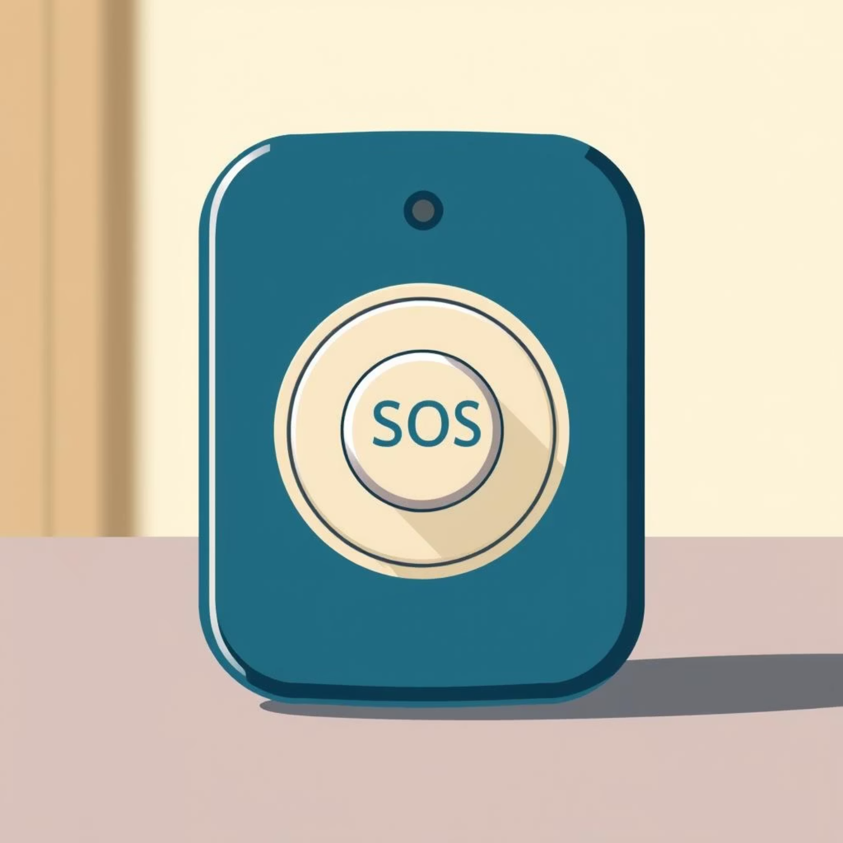
Core Features: Immediate Protection at Your Fingertips
One-Tap SOS Button
Sends instant alert to pre-saved trusted contacts.
Message includes live GPS location for precise assistance.
Location Tracking
Live map updates user location every few seconds.
Continues tracking until the user is marked
Offline Support
If no internet uses SMS fallback

Slide 6

Enhanced Safety: Beyond Basic Alerts
Voice Activation
Triggers SOS by saying "Help me" or "Emergency."
Integrates Whisper (OpenAI) or browser mic input for seamless activation.
Panic Mode Timer
Press and hold the button for 3 seconds to trigger emergency mode.
Initiates a 10-second silent countdown before alerting contacts.

Slide 7




Reliable Communication Even Offline
Our system ensures that alerts always go through, even without an internet connection, providing a robust safety net.
No Internet? No Problem.
SMS Fallback Protocol
Automatically switches to SMS fallback if internet is unavailable.
Sends a direct SMS message to trusted contacts, ensuring the alert always goes through.
Last Known Location
Vonage API Integration
Alert includes the approximate last known GPS location, aiding rescue efforts.
Utilizes Vonage API for reliable and efficient SMS delivery.

Slide 8
Technology & Architecture
The SOS App is built on a robust, modern technology stack designed for reliability, speed, and user experience.
Layer
Tool
Description
UI
Streamlit
For intuitive and responsive user interface, ensuring ease of use.
AI Engine
Hugging Face
Powers advanced features like voice activation and intelligent alert processing.
Logic Dev
Python on Google Colab
Enables rapid prototyping and scalable development of core functionalities.
Location
Streamlit Map
Integrates live mapping capabilities for real-time location tracking.
SMS (Demo)
Simulated
Demonstrates SMS fallback for offline alerts, crucial for remote areas.
Deployment
Hugging Face Spaces
Ensures secure and efficient deployment, providing continuous availability.

Slide 9





High-Level System Diagram
Understand the seamless flow of our emergency alert system, from user activation to reliable alert delivery and monitoring.
User Activation
Initiated by button press or voice command.
App Processing
Streamlit UI and AI engine process input and location data.
Alert Transmission
Alerts sent via internet or SMS fallback.
Real-Time Monitoring
Location displayed on map with continuous logging.
Secure Deployment
System hosted on Hugging Face for public access.

Slide 10
Thank You,
We appreciate your time and attention. If you have any questions or would like to learn more, please don't hesitate to contact us.

